Slide 1


Napollo Software Design LLC

Slide 2

  Overview
Our initial scope of work involved preparing design templates shared on Figma which has been completed 90%. Now the project scope has been deviated to custom backend functionalities
During the period of 3 weeks, we have discussed various iteration changes and functionalities on Figma and also in our weekly status update meetings where we feel that the direction of the project has deviated from the original scope of work and requires a review
We’ve developed announcement module and release notes module backend through custom post types and custom functions to programmatically flow and data. This work was not part of the initial scope of work and has impact on agreed timelines and agreed budget.
Some of the designs were modified like header revamp, announcements on top of each other, etc.
There are missing flows in the Figma design which we believe would surface once you’ve spent more time like “All Training Materials” page.

Slide 3
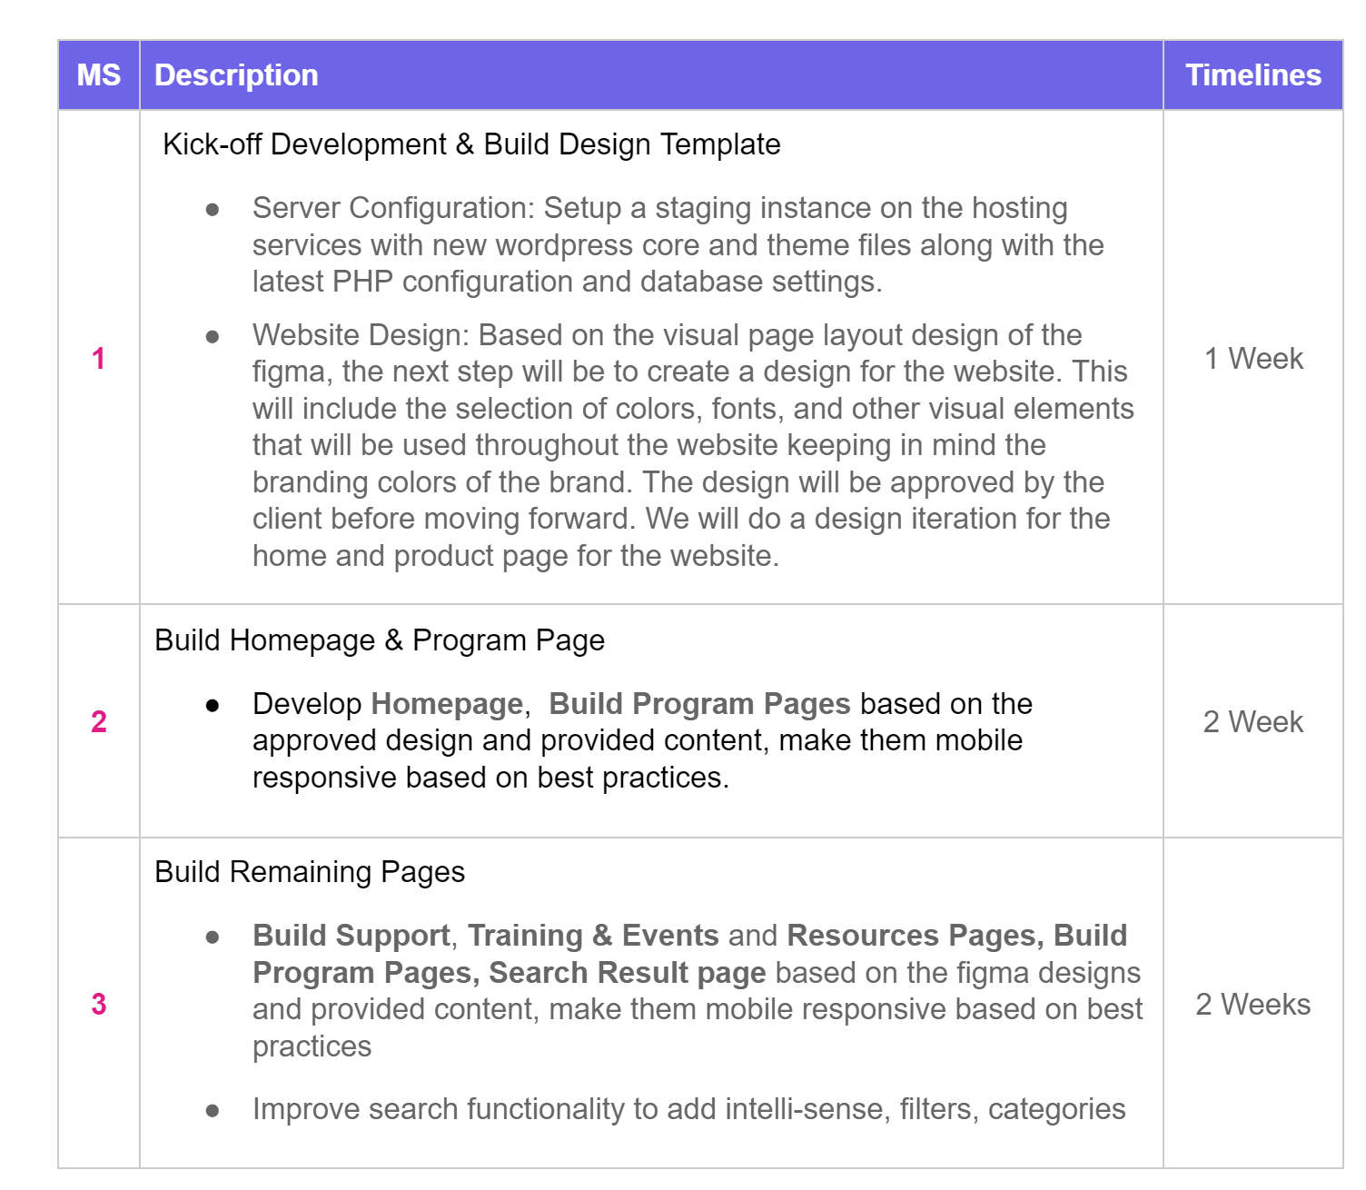
  Change Requests / Iterations VS Initial Scope
Sr. | Iteration Description (brief, details in next slide)
1 | Revamp Header Design after development
2 | Design Announcements backend through custom post types with front-end data connections
3 | Add conditional logics to announcement bar to either show or hide announcement bar based on custom field data
4 | Design Release Notes backend through custom post types
5 | Add conditional logics to release notes bar to either show or hide release notes data based on custom field data
6 | Custom admin post list columns
7 | Custom post section for News & Release Notes if we need to show post types

Slide 4
  Hours Required , Spent & Remaining for Change Requests
Sr. | Iteration Description | Change Request Date | Required Hours | Hours Spent | Remaining Hours
1 | Revamp Header Design | May 30th | 8 | 8 | 10
2 | Design Announcements backend through custom post types with front-end data connections | May 25th | 18 | 12 | 6
3 | Add conditional logics to announcement bar to either show or hide announcement bar based on custom field data | May 25th | 8 | 8 | NA
4 | Design Release Notes backend through custom post types | May 25th | 40 | 16 | 24
5 | Add conditional logics to release notes bar to either show or hide release notes data based on custom field data | May 25th | 18 | 18 | NA
6 | Custom admin post list columns | June 1st | 10 | 4 | 6
7 | Custom post section for News & Release Notes if we need to show post types | June 1st | 24 | 10 | 14
8 | All Training Material Page | May 30th | 20 | NA | NA
9 | Update news page functionality since Release Notes is a custom post type, we need to write function for that page to work smoothly | - | 14 | - | -
10 | Anticipate All intake form page from programs page which is not available in Figma | - | 20 | - | -

Slide 5
  Way Forward
Complete the Figma designs as per the agreed initial scope and hand-over.
Approve the cost and extend timelines.
All change requests will be based on hourly rate $49.

