Slide 1

2024-2025 Housing Inventory Training
Sheltered Programs:
ES, TH, SH, RRH, PSH, OH

Slide 2
Important Contact Information
Jim Bombaci
Nutmeg IT
Jim@NutmegIT.Com
Shannon Quinn-Sheeran
Housing Innovations
Shannon@HousingInnovations.US
Lindsay Fabrizio
The Housing Collective
Lindsay@TheHousingCollective.Org
Nutmeg Help Desk
Help@NutmegIT.Com
CT BOS Contact
ctboscoc@gmail.com
ODFC Contact
Lindsay@TheHousingCollective.Org

Slide 3
Meeting Agenda
Introductions
Roles and Responsibilities
Program Overview
Housing Inventory Count (HIC)
PIT Database Demo
Key Dates
Summary
Questions/Close

Slide 4
Roles and Responsibilities
Project Management – PIT Leadership Team
Database Support – Nutmeg
Bed Change Confirmation/Review
  CTBOS: Housing Innovations
  ODFC: The Housing Collective
Bed Count Confirmation Monitoring
  CTBOS and ODFC

Slide 5
Federal Requirements for Counting People Experiencing Homelessness & Inventory
Purpose of Counts
HIC (Housing Inventory Count): Count units & beds dedicated to community members experiencing homelessness.
PIT (Point-in-Time Count): Count individuals experiencing homelessness in sheltered & unsheltered spaces. (not meant for human habitation).
Timing of Counts
HIC: Starts now; adjustments for unknown/unexpected changes for 1/28/25
PIT: Conducted within the last 10 days of January. CT PIT count on 1/28/2025.
Areas of Focus
HIC: Count available units & beds in housing programs (HMIS and Non-HMIS)
PIT: Count total households & individuals in those units/beds on 1/28/25.
Notes:
HIC: units/beds in programs for which homelessness is an entry criteria
Timing: during colder time of winter when homelessness is at its peak.

Slide 6

Federal Requirements for HIC & PIT (2)
Importance of the Counts
Snapshot of Homelessness: Provides annual insights into homelessness trends.
Ultimate goal
Determine federal funding and resource allotment/eligibility for Connecticut.

Slide 7
Overview
The PIT counts people experiencing homelessness within each Continuum of Care’s geographic region.
Populations included in PIT:
Emergency Shelter (ES)
Transitional Housing (TH
Safe Haven (SH)
Unsheltered Situations
The HIC includes a people count for each program
Populations included in HIC:
ES, TH, SH
Rapid Rehousing (RRH)
Permanent Supportive Housing (PSH)
Notes:
TH includes the TH portion of Joint TH/RRH projects
For the 1st grouping – those people are considered to be experiencing homelessness
PH participants are also counted – as part of ppl within the homeless services system, but not considered to be experiencing homelessness at time they are in these housing programs.

Slide 8
Overview Continued
Unsheltered - living in places not meant for human habitation, for example, outside, in bus stations, in cars, etc.
RRH and PSH – Programs considered permanent housing
Participants are counted and reported to HUD
  Fewer demographics reported
  No longer considered to be experiencing homelessness

Slide 9
Housing Inventory Count (HIC)
Purpose: Track the capacity to meet the needs of people experiencing homelessness in CT
Tasks:
  updating housing program information and
  units and beds available for people experiencing homelessness throughout the state
Includes:
  Emergency Shelters (ES)
  Safe Havens (SH)
  Transitional Housing (TH)
  Rapid Rehousing (RRH)
  Permanent Supportive Housing (PSH)
  Other Permanent Housing (OPH)
Notes:
Important to Review & Update Housing Program information:

Slide 10
Housing Inventory Count (HIC) Steps
Coordinated through the PIT Database - online database to update project capacity
Timeframe:
Submit Help Desk tickets by 11/1/2024
Confirm Data by 11/8/2024
Update if any unforeseen changes in mid-January
Steps in PIT Database:
  Identify & ensure inclusion of all projects dedicated to housing people experiencing homelessness
    New Project form: email help desk (help@nutmegit.com) to request
      Must include housing type & federal funding source
Notes:
# 2 especially important with new import system for getting the data into HUD’s database. Addresses important.

Slide 11
HIC Steps in PIT Database Cont’d
  Review & confirm/update as necessary project details (address, funding source)
    Site-based require physical address (except DV)
    Scattered site – report location of most beds, may use agency address
    DV programs – include only Zip Code
    GPD Programs require specific fund type (Bridge, Clinical, etc.)
    New: Click checkbox confirming address us current/accurate
  Review & update/confirm all unit & bed numbers for each project
      Beds for families (adult over 18 w/ child(ren)) vs. single adults
      Beds for specialized populations (e.g. Veterans & Youth)
Note: PIT Leadership Team will review bed capacity & may make changes to align project information project applications

Slide 12
Rapid Rehousing Process
Important Dates:
Confirm Bed Inventories: Wait until after the count on 1/28/2025
Data Entry/Confirmation Deadline: 2/4/2025
Process Overview:
After confirmation, HIC will auto-populate to match household & people counts
Key Reminder:
After confirming Population Data, RRH users must review and confirm that the bed counts (HIC) have auto-populated correctly.
RRH Bed numbers must be identical to the number of people housed and receiving services (case management without rental payments do count)

Slide 13
PIT Steps
  Reminder: PIT = people portion & counts the people experiencing homelessness on the night of the count
  Timeline:
Confirm People Count: Night of 1/28/2025 or after
Data Entry/Confirmation Deadline: 2/4/2025
Brief Overview:
Completed via PIT database: staff either review (HMIS participant projects) or enter (non-HMIS participating projects) total people sleeping in the program on the night of the count
Providers, Regional Coordinators, CoC Leadership, and Nutmeg collaborate to ensure all projects enter and/or verify data in a timely fashion

Slide 14

PIT Database Demonstration

Slide 15
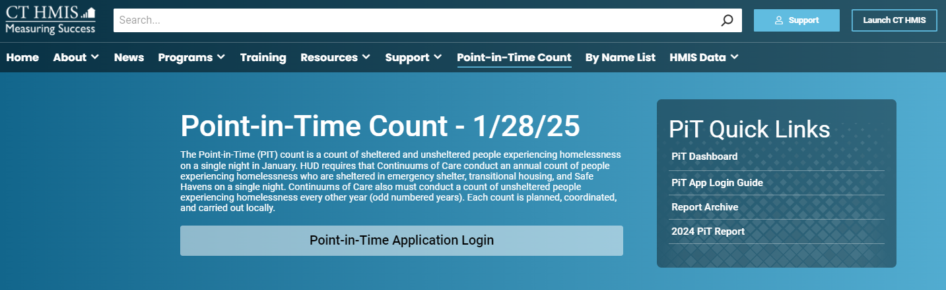
PIT App Training:
Information Page
CTHMIS PIT Information Page
https://cthmis.com/pit/

Slide 16
PIT App Training:
Shelter/Housing Based Programs
HMIS Participating and Non-HMIS Programs:
ES – Emergency Shelter
SH – Safe Haven
TH – Transitional Housing
PH – Permanent Housing
RRH – Rapid Re-Housing
OH – Other Housing

Slide 17
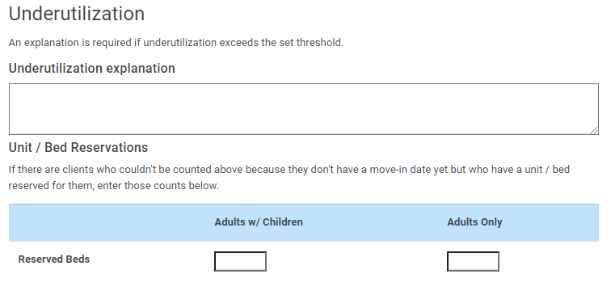
PIT App Training:
Shelter/Housing Based Programs
New for 2024-2025 Count
PSH Reserved Bed Data Collection - For ALL PSH HMIS and Non-HMIS programs, If the number of beds are greater than the number of people counted, you will need to provide not only the explanation but also a count of beds that are reserved, if any.

Slide 18
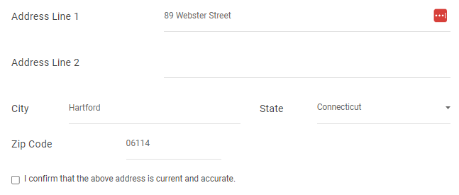
PIT App Training:
Shelter/Housing Based Programs
New for 2024-2025 Count
Address confirmation for all programs – Users will need to verify the address for each program and click on the confirmation box in the address section. Scattered site PSH can use the agency address and DV programs are only required to provide the zip code.

Slide 19
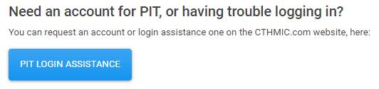
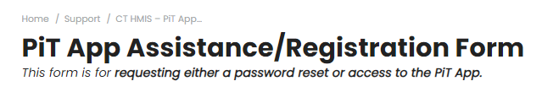
PIT App Training:
Shelter/Housing Based Programs
New for 2024-2025 Count
Submit a help desk ticket button on the PIT login page - This button will be for any login issues or to register as a PIT DB user.
Clicking on the button will bring you the ticket submission form

Slide 20
PIT App Training:
Shelter/Housing Based Programs
HMIS Participating Programs:
Similar to the count process last year, all HMIS programs will have their people count data imported to the PIT database directly from HMIS
ES, TH, SH & PSH Programs must first complete and confirm their bed count information and then the PIT count feature will be active.
RRH Programs will review and confirm their people count data on the night of the PIT count and then confirm their bed data.
You will be able to start working with the people count immediately for this year. This will allow users to actively test their data and clean up their data all the way up to the night of the count.
All programs are encouraged to refresh and review their PIT data to make sure the counts are correct and make sense.

Slide 21
PIT App Training:
Shelter/Housing Based Programs
The rules that will pull client data into the PIT App are the same for all program types as last year
Emergency Shelter:
  Open enrollment
  ES Check-in dated on the night of PIT - all household members
Safe Haven and Transitional Housing
  Just need an open enrollment
Permanent Housing and Rapid Re-Housing:
  Open enrollment
  Move in date dated on or before the night of PIT - Head of Household
Emergency Shelter Hotel/Motel
  Open enrollment
  ‘Motel/Hotel Costs’ service dated on the night of PIT - Head of Household

Slide 22
PIT App Training:
Shelter/Housing Based Programs
Also part of the PIT process is the Funder Type review.
Example, Joint TH-RRH – Transitional Housing – Rapid re-Housing
This is a funder type that requires that there be two specific programs.
One for TH and one for RRH
If your funder type is Joint TH/RRH, make sure that you have two distinct programs available

Slide 23
PIT App Training:
Shelter/Housing Based Programs
Non-HMIS Programs:
If you are part of a Non-HMIS participating program and you DID NOT manage data for the PIT count last year, then I will need the following:
  First name, last name and email
  Name of program or programs you will need access to
If there is a new housing program that is not currently listed in the PIT App then, I will need the program set up sheet to be completed and submitted.
Submit a help desk ticket to request the program set up sheet:
Help@nutmegit.com

Slide 24
PIT App Training:
Sheltered HMIS and Non-HMIS
Non-HMIS Programs:
All Non-HMIS programs will be able to confirm their beds in the PIT App similar to last year.
As with the HMIS participating programs, the Non-HMIS programs will use the same bed change feature now in the PIT database

Slide 25
PIT App Training:
Shelter/Housing Based Programs
Bed Change Form Process – same process as last year
Automated Bed Change Process
    If a bed or unit number needs to change:
    Enter the new number
    Submit to the CoC for review
    The CoC will view a report showing your change & can either confirm or deny the change.
RRH Bed Count Drop Alert
  On the night of the count:
    After confirming people, check & confirm the bed (HIC) count
    If the bed count is lower than last year, an alert will appear.
  Next Steps:
    Confirm If the numbers of people and beds are correct.
    If incorrect, determine if a client record is missing from the people count & adjust HMIS data as needed.
Non-HMIS PSH Reporting – Same process as last year
  Bed count process remains the same
  Provide Household and Person Totals Only
    the total number of households
    the total number of people

Slide 26
Important Dates & Resources
To Do:
10/24 -11/8 Ensure all projects are in PIT Database
10/24 - 11/8: All PSH, ES, TH and SH Providers Update Beds
11/4: Due date for help desk tickets
1/28/2025: Night of the count
There will be automated email notifications sent out to users who are assigned to a program or programs that have not completed either Bed or People confirmations

Slide 27
Important Dates & Resources
To Do:
1/28/2025: Begin entering/confirming population data
2/4/25: Data Entry deadline (1 week after “night of the count”)
Project resources:
2024-2025 HIC/PIT Resource Website
If project not yet in the system, contact the help desk:
Help@NutmegIT.Com

Slide 28
Important Contact Information
Jim Bombaci
Nutmeg IT
Jim@NutmegIT.Com
Shannon Quinn-Sheeran
Housing Innovations
Shannon@HousingInnovations.US
Lindsay Fabrizio
The Housing Collective
Lindsay@TheHousingCollective.Org
Nutmeg Help Desk
Help@NutmegIT.Com
CT BOS Contact
ctboscoc@gmail.com
ODFC Contact
Lindsay@TheHousingCollective.Org

Slide 29

Questions

