Slide 1

2024-2025 Unsheltered Training
Unsheltered Programs: Street Outreach/Warming Centers

Slide 2
Agenda
Introductions & Agenda
Roles & Responsibilities
Program Overview
Unsheltered Count Process and Data Clean Up
PIT Database Demo
Key Dates
Contact Info/Reference Links
Questions

Slide 3
Important Contact Information
Jim Bombaci Nutmeg IT Jim@NutmegIT.Com
Shannon Quinn-Sheeran Housing Innovations Shannon@HousingInnovations.US
Lindsay Fabrizio The Housing Collective Lindsay@TheHousingCollective.Org
Nutmeg Help Desk Help@NutmegIT.Com
CT BOS Contact ctboscoc@gmail.com
ODFC Contact Lindsay@TheHousingCollective.Org

Slide 4
Roles and Responsibilities
Project Management – PIT Leadership Team
Database Support – Nutmeg
Program List Confirmation/Review
CTBOS: Housing Innovations
ODFC: The Housing Collective
Current Living Situation Assessment Confirmation Monitoring
Regional Coordinators
CTBOS and ODFC

Slide 5
Federal Requirements for Counting People Experiencing Homelessness & Inventory
Purpose of Counts
HIC (Housing Inventory Count): Count units & beds dedicated to community members experiencing homelessness.
PIT (Point-in-Time Count): Count individuals experiencing homelessness in sheltered & unsheltered spaces. (not meant for human habitation).
Timing of Counts
HIC: Starts now; adjustments for unknown/unexpected changes for 1/28/25
PIT: Conducted within the last 10 days of January. CT PIT count on 1/28/2025.
Areas of Focus
HIC: Count available units & beds in housing programs (HMIS and Non-HMIS)
PIT: Count total households & individuals in those units/beds on 1/28/25.

Slide 6

Federal Requirements for HIC & PIT (2)
Importance of the Counts
Snapshot of Homelessness: Provides annual insights into homelessness trends.
Ultimate goal
Determine federal funding and resource allotment/eligibility for Connecticut.

Slide 7
Overview
The Point in Time (PIT) counts people experiencing homelessness within each Continuum of Care’s geographic region.
Populations included in PIT:
Emergency Shelter (ES)
Transitional Housing (TH)
Safe Haven (SH)
Unsheltered Situations
Street Outreach (SO)
Youth Navigator
The HIC includes a people count for each program.
Populations included in HIC:
ES, TH, SH
Rapid Rehousing (RRH)
Permanent Supportive Housing (PSH)
Notes:
Considered homeless: Includes people in the TH portion of Joint TH-RRH programs & the folks in the RRH portion of this are considered in PH

Slide 8
Overview Continued
Unsheltered = people living in places not meant for human habitation, for example, outside, in bus stations, in cars, etc.
RRH and PSH = Programs considered permanent housing
Participants are counted and reported to HUD
Fewer demographics reported
No longer considered to be experiencing homelessness

Slide 9
Unsheltered Count
HMIS Participating Agencies - rely on HMIS to review & confirm data so it reports correctly in the PIT Database
Current Living Assessment Due Date 2/4/2025
Non-HMIS Warming Centers and Outreach Programs will use the Smart Sheet form.
The Smart Sheet forms Due Date 2/4/2025
Notes:
CLA data due date: SO programs have a 7 day look-back period to

Slide 10

PIT Database Demonstration

Slide 11
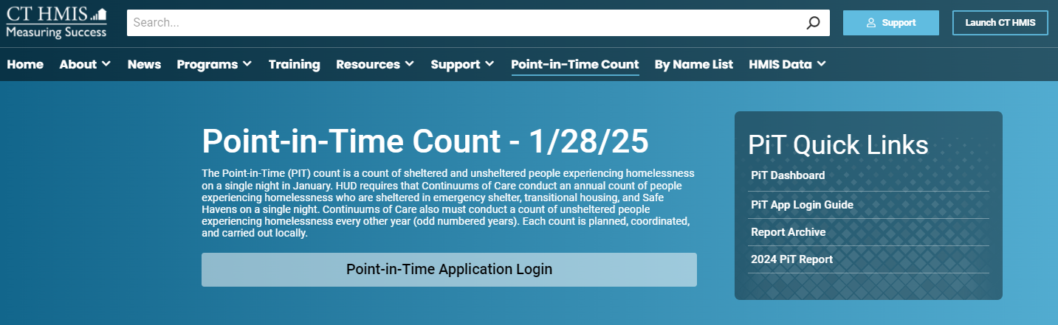
PIT App Training: Information Page
CTHMIS PIT Information Page
https://cthmis.com/pit/

Slide 12
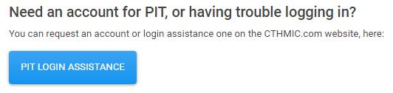
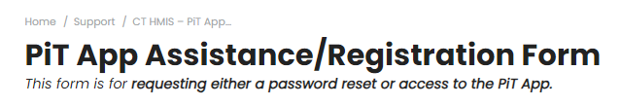
PIT App Training: Shelter/Housing Based Programs
New for 2024-2025 Count
Submit a help desk ticket button on the PIT login page - This button will be for any login issues or to register as a PIT DB user.
Clicking on the button will bring you the ticket submission form

Slide 13
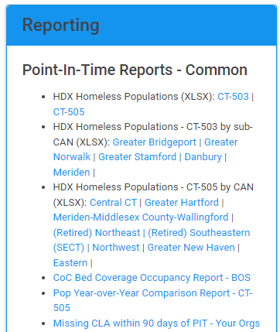
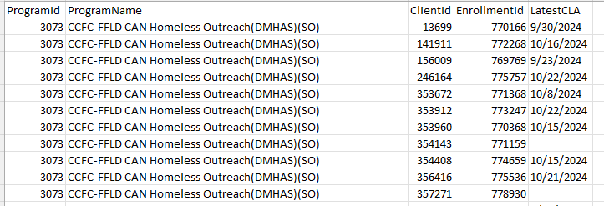
PIT App Training: Shelter/Housing Based Programs
New for 2024-2025 Count
All HMIS Outreach programs can run their own “Missing Current Living Situation Assessment” Report.
From the Right-side menu, in the Point-In-Time Reports section
Click on the Missing CLA report

Slide 14
PIT App Training: Unsheltered HMIS and Non-HMIS
Similar to the count process last year, HMIS participating SO programs will be using the HMIS Current Living Situation Assessment
The Head of Household for each client record will need the following to counted on the night of PIT:
Open program enrollment
Current Living Situation Assessment dated for the night of the PIT count
A homeless setting selected as the current living situation

Slide 15
PIT App Training: Unsheltered HMIS and Non-HMIS
Similar to the count process last year, Non-HMIS participating SO programs will have access to the Smart Sheet data collection form.
This form will allow the user to enter the necessary data to populate the PIT tables as well as de-duplicate based on client records who have already been counted.
If you are new to the PIT process, then I will need to know the user information
First, Last and Email
Name of SO program

Slide 16
PIT App Training: Unsheltered HMIS and Non-HMIS
If there is a new SO program that is not currently listed in the PIT App, then I will need the program set up sheet to be completed and submitted.
To obtain the program set up sheet, please email our help desk:
Help@nutmegit.com

Slide 17
PIT App Training: Unsheltered HMIS and Non-HMIS
Non-HMIS SO/Warming Centers:
DOH Warming Center programs and Outreach programs will use the same smart sheet data entry form as last year.
The user will need to provide as much information as possible in order to assess for duplicate records
Once complete we will import the data into the PIT database for you. The deduplication will be automated so only the unduplicated data will populate the PIT tables
Your job will be to simply confirm the counts for you program in the PIT database once the import is complete

Slide 18
PIT App Training: Unsheltered HMIS and Non-HMIS
Similar to 2024:
We will be cross referencing the BNLv2 Chronic Homeless client data against the PIT App confirmed homeless on the night of the count data
If a person is counted as Chronic on the BNLv2 but is not showing as meeting the homeless requirements for then night of the count, then that person will not be counted among the Chronic Homeless on the night of PIT

Slide 19
Important Dates & Resources
10/24/2024: Begin evaluating the ‘missing Current Living Assessment (CLA)’ report
Shows program participants which haven’t had a CLA completed within the past 90 days
Recommend entering a CLA for all participants who are still active in the program to confirm enrollments are up-to-date
1/14/2025: Ensure CLAs & Client Lists are up-to-date
1/28/2025: Night of Count
1/28 evening - 2/4/2025: See/Speak with participants – determine sleeping location on 1/28/25, completing CLAs for 1/28/25 as you go
2/4/2025: Data Entry deadline
Project resources:
2023-2024 HIC/PIT Resource Website
If you need assistance, contact the help desk:
Help@NutmegIT.Com
Notes:
Cannot assume you know where a person slept on 1/28/25. Must see and/or speak with them to confirm where they slept on that night.

Slide 20
Important Contact Information
Jim Bombaci Nutmeg IT Jim@NutmegIT.Com
Shannon Quinn-Sheeran Housing Innovations Shannon@HousingInnovations.US
Lindsay Fabrizio The Housing Collective Lindsay@TheHousingCollective.Org
Nutmeg Help Desk Help@NutmegIT.Com
CT BOS Contact ctboscoc@gmail.com
ODFC Contact Lindsay@TheHousingCollective.Org

Slide 21

Questions

