Slide 1

2024-2025 Sheltered People Count Training
Sheltered Programs:
ES, TH, SH, RRH, PSH, OH

Slide 2
Important Contact Information
Jim Bombaci
Nutmeg IT
Jim@NutmegIT.Com
Shannon Quinn-Sheeran
Housing Innovations
Shannon@HousingInnovations.US
Lindsay Fabrizio
The Housing Collective
Lindsay@TheHousingCollective.Org
Nutmeg Help Desk
Help@NutmegIT.Com
CT BOS Contact
ctboscoc@gmail.com
ODFC Contact
Lindsay@TheHousingCollective.Org

Slide 3
Meeting Agenda
Introductions
Roles and Responsibilities
Program Overview
PIT Database Demo
Key Dates
Summary
Questions/Close

Slide 4
Roles and Responsibilities
Project Management – PIT Leadership Team
Database Support – Nutmeg
HMIS Participating People Counts
  Agency Staff
Non-HMIS Participating People Counts
  Agency Staff

Slide 5
What is the Point-in-Time Count?
Federal Program designed to count number of community members experiencing homelessness, in both sheltered and unsheltered spaces. (not meant for human habitation)
When do we perform the count?
- Typically occurs within the last 10 days of Jan. During the colder time of the winter when homelessness is at
its peak. The CT PIT count is on 1/28/2025
Where/What are we counting?
- Where: Housing programs both HMIS and Non-HMIS participating will provide a count of their available beds
on the night of the count they will provide a count of total households and persons.
Why do we do it?
- The PIT provides a snapshot of the homelessness population on/around the same time each year; which
helps identify population trends.
What is the ultimate goal?
Helps to determine the amount of federal funds and resources our state is eligible for/allotted

Slide 6
Federal Requirements for Counting People Experiencing Homelessness & Inventory
Purpose of Counts
HIC (Housing Inventory Count): Count units & beds dedicated to community members experiencing homelessness.
PIT (Point-in-Time Count): Count individuals experiencing homelessness in sheltered & unsheltered spaces. (not meant for human habitation).
Timing of Counts
HIC:
  Completed in the fall (except RRH);
  Now – make adjustments for unknown/unexpected changes for 1/28/25;
  RRH completed at time of PIT
PIT: Conducted within the last 10 days of January. CT PIT count on 1/28/2025.
Areas of Focus
HIC: Count available units & beds in housing programs (HMIS and Non-HMIS)
PIT: Count total households & individuals in those units/beds on 1/28/25.
Notes:
LF Start
HIC: units/beds in programs for which homelessness is an entry criteria
Timing: during colder time of winter when homelessness is at its peak.

Slide 7

Federal Requirements for HIC & PIT (2)
Importance of the Counts
Snapshot of Homelessness: Provides annual insights into homelessness trends.
Ultimate goal
Determine federal funding and resource allotment/eligibility for Connecticut.

Slide 8
Overview
The Point in Time (PIT) is a count of people within the Continuum of Care’s geographic region who are experiencing homelessness. This includes people in
ES-Emergency Shelter
TH-Transitional Housing
SH-Safe Haven(s)
Unsheltered Situations
People in permanent housing within the CoC are also counted:
RRH – Rapid Rehousing
PSH – Permanent Supportive Housing
PH/OPH – Permanent and Other Permanent
Notes:
TH includes the TH portion of Joint TH/RRH projects – these show up as either a TH program type or an RRH program type not both. The funder type is Join TH/RRH

Slide 9
Overview Continued
Unsheltered = people living in places not meant for human habitation, for example, outside, in bus stations, in cars, etc.
RRH, PSH, PH, OPH = projects that have had homelessness as a criteria for project entry. Persons are also counted and reported to HUD, but are no longer considered to be experiencing homelessness

Slide 10
Point In Time Count
Why: Required by HUD. Combined with the HIC, PIT shows capacity to meet the needs of people experiencing homelessness in each CoC
  PIT = people portion and counts the people experiencing homelessness on the night of the count
  Also completed via the PIT database: agency staff either review (HMIS participant projects) or enter (non-HMIS participating projects) total people sleeping in the program on the night of the count
  Regional Coordinators work with CoC Leadership, providers, and Nutmeg to ensure all projects enter and/or verify data in a timely fashion

Slide 11
Important Links
PIT App link: PIT Database Link
PIT Resource Page: https://cthmis.com/pit/
  General User Guides
  Unsheltered Programs Training Material
  Sheltered Program Training Material

Slide 12
Rapid Rehousing
Enter and/or confirm data by 2/4/2025
After confirmation – HIC auto-populates to match the household and people counts.
Important: After confirming your Population Data, RRH users must then go to Bed Counts to review and confirm that the beds have auto populated correctly.
Users must click “Confirm” for the HIC data to register as accurate
RRH Bed inventory must be identical to the number of people housed and receiving services (case management without rental payments, do count) For the night of the count, RRH providers confirm their “people”
Notes:
Have made some modifications and GPD, SSVF, YHDP and RHY programs SHOULD all auto-populate, but not other programs. All should check/verify that they are correct, and adjust as necessary.
GPD, SSVF, YHDP and RHY people data does not auto populate – that was a bed count feature only. Only RRH people data triggers RRH bed data

Slide 13
PIT App Training:
Sheltered HMIS and Non-HMIS
HMIS Participating and Non-HMIS Programs:
ES – Emergency Shelter
SH – Safe Haven
TH – Transitional Housing
PSH – Permanent Supportive Housing (includes EHV’s)
RRH – Rapid Re-Housing
OPH – Other Housing
PH – Permanent Housing
Notes:
There are 2 Joint TH-RRH programs in the CT BOS CoC. In HMIS, they are set up separately for the TH portion and the RRH portion and will report that way.

Slide 14
PIT App Training:
Sheltered HMIS and Non-HMIS
HMIS Participating Programs:
Similar to the count process last year, all HMIS programs will have their people count data imported to the PIT database directly from HMIS
ES, TH, SH, PSH, PH and OPH Programs must first complete and confirm their bed count information and then the PIT count feature will be active.
RRH Programs will review and confirm their people count data which update their bed data. Then, need to confirm bed (HIC) data.

Slide 15
PIT App Training:
Sheltered HMIS and Non-HMIS
The rules that will pull client data into the PIT App are the same for all program types as last year. For HMIS Participating:
Emergency Shelter:
  Open enrollment
  ES Check-in dated on the night of PIT - all household members
Safe Haven and Transitional Housing
  Just need an open enrollment
Permanent Housing, Rapid Re-Housing
  Open enrollment
  Move in date dated on or before the night of PIT - Head of Household
Emergency Shelter Hotel/Motel
  Open enrollment
  Motel/Hotel Costs service dated on the night of PIT - Head of Household

Slide 16
PIT App Training:
Sheltered HMIS and Non-HMIS
Non-HMIS Programs:
Manual Data Entry in the People Count fields
PSH, VASH, PH, OPH will only require Household and People count totals – no demographic information will be collected.
  Emergency Housing Vouchers (EHVs) and Housing Stabilization Vouchers (HSVs) are included in OPH category above.
If you are part of a Non-HMIS participating program and you DID NOT manage data for the PIT count last year, then I will need the following:
  First name, last name and email
  Name of program or programs you will need access to
If there is a new housing program that is not currently listed on the PIT App program sheet, then I will need the program set up sheet to be completed and submitted.
Submit a help desk ticket to request the program set up sheet:
Help@nutmegit.com
Notes:
Highlight that EHVs and HSVs are part of the Other Permanent Housing category, and, as such, they need only Household type (adults w/ children or adult only) and # of people in each type.

Slide 17
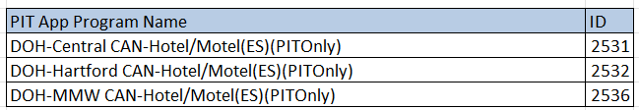
PIT App Training:
Sheltered HMIS and Non-HMIS
DOH Non-HMIS Hotel/Motel Programs – Similar to last year, the Smartsheets data will be used to populate the PIT tables.
Nutmeg will review the Smartsheets and remove any duplicate client records that have already been accounted for on the night of PIT.
After the dups have been removed, we will send the sheets back to the users assigned to these programs below who will then be able to complete the PIT tables in the PIT database.

Slide 18
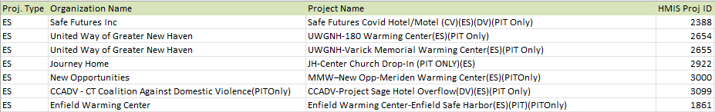
PIT App Training:
Sheltered HMIS and Non-HMIS
Non-HMIS Warming Center ES:
For these programs, the user will go to this link below to enter all persons encountered on the night of PIT, this includes each household member.
Non HMIS DOH Outreach and Warming Center Smart Sheet Form
2025 SmartSheet Link: SmartSheet Intake Form
PIT Resources, Unsheltered: https://cthmis.com/pit/
Non-HMIS Warming Center ES Programs:

Slide 19
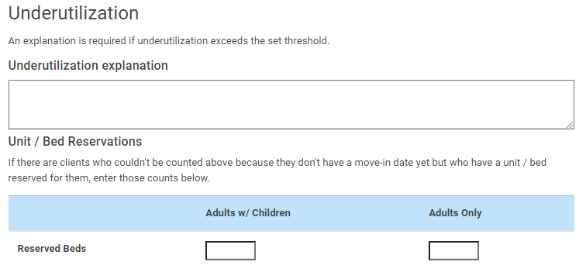
Reserved Bed Data Collection
New for 2024-2025 Count
PSH Reserved Bed Data Collection - For ALL PSH HMIS and Non-HMIS programs, If the number of beds are greater than the number of people counted, you will need to provide not only the explanation but also a count of beds that are reserved, if any.

Slide 20
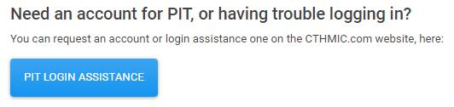
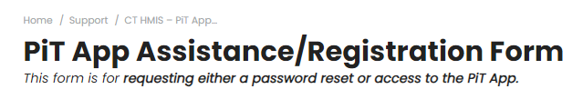
Reserved Bed Data Collection
New for 2024-2025 Count
Submit a help desk ticket button on the PIT login page - This button will be for any login issues or to register as a PIT DB user.
Clicking on the button will bring you the ticket submission form

Slide 21

PIT Database Demonstration

Slide 22
Important Dates & Resources
To Do:
1/28/2025 : Begin entering/confirming population data
  Be sure to know where slept on 1/28/25 prior to confirming data
2/4/25: Data Entry deadline (1 week after “night of the count”)
Project resources:
2024-2025 HIC/PIT Resource Website
If project not yet in the system, contact the help desk:
Help@NutmegIT.Com

Slide 23
Important Contact Information
Jim Bombaci
Nutmeg IT
Jim@NutmegIT.Com
Shannon Quinn-Sheeran
Housing Innovations
Shannon@HousingInnovations.US
Lindsay Fabrizio
The Housing Collective
Lindsay@TheHousingCollective.Org
Nutmeg Help Desk
Help@NutmegIT.Com
CT BOS Contact
ctboscoc@gmail.com
ODFC Contact
Lindsay@TheHousingCollective.Org

Slide 24

Questions

