Slide 1

2024-2025 Un-Sheltered People Count Training
Un-Sheltered Programs:
PATH, Street Outreach and Non-ES Warming Centers

Slide 2
Important Contact Information
Jim Bombaci Nutmeg IT Jim@NutmegIT.Com
Shannon Quinn-Sheeran Housing Innovations Shannon@HousingInnovations.US
Lindsay Fabrizio The Housing Collective Lindsay@TheHousingCollective.Org
Nutmeg Help Desk Help@NutmegIT.Com
CT BOS Contact ctboscoc@gmail.com
ODFC Contact Lindsay@TheHousingCollective.Org

Slide 3
Meeting Agenda
Introductions
Roles and Responsibilities
Program Overview
PIT Database Demo
Key Dates
Summary
Questions/Close

Slide 4
Roles and Responsibilities
Project Management – PIT Leadership Team
Database Support – Nutmeg
HMIS Participating People Counts
Agency Staff
Non-HMIS Participating People Counts
Agency Staff

Slide 5
Federal Requirements for Counting People Experiencing Homelessness & Inventory
Purpose of Counts
HIC (Housing Inventory Count): Count units & beds dedicated to community members experiencing homelessness.
PIT (Point-in-Time Count): Count individuals experiencing homelessness in sheltered & unsheltered spaces. (not meant for human habitation).
Timing of Counts
HIC: Completed in fall (except RRH); adjustments now for unknown/unexpected changes for 1/28/25. RRH completed at time of PIT count.
PIT: Conducted within the last 10 days of January. CT PIT count on 1/28/2025.
Areas of Focus
HIC: Count available units & beds in housing programs (HMIS and Non-HMIS)
PIT: Count total households & individuals in those units/beds on 1/28/25.
Notes:
LF Start

Slide 6
What is the Point-in-Time Count?
Federal Program designed to count number of community members experiencing homelessness, in both sheltered and unsheltered spaces. (not meant for human habitation)
When do we perform the count?
- Typically occurs within the last 10 days of Jan. During the colder time of the winter when homelessness is at
its peak. The CT PIT count is on 1/28/2025
Where/What are we counting?
- Where: Housing programs both HMIS and Non-HMIS participating will provide a count of their available beds
on the night of the count they will provide a count of total households and persons.
Why do we do it?
- The PIT provides a snapshot of the homelessness population on/around the same time each year; which
helps identify population trends.
What is the ultimate goal?
Helps to determine the amount of federal funds and resources our state is eligible for/allotted

Slide 7
Point In Time Count
Why: Required by HUD. Combined with the Housing Inventory Count (HIC), the PIT shows capacity to meet the needs of people experiencing homelessness in each CoC
PIT = people portion and counts the people experiencing homelessness on the night of the count
Also completed via the PIT database: agency staff either review (HMIS participant projects) or enter (non-HMIS participating projects) total people sleeping in the program on the night of the count
Regional Coordinators work with CoC Leadership, providers, and Nutmeg to ensure all projects enter and/or verify data in a timely fashion

Slide 8

Federal Requirements for HIC & PIT (2)
Importance of the Counts
Snapshot of Homelessness: Provides annual insights into homelessness trends.
Goal
Determine federal funding and resource allotment/eligibility for Connecticut.

Slide 9
Overview
The Point in Time (PIT) counts people experiencing homelessness within each Continuum of Care’s geographic region.
Populations included in PIT:
Emergency Shelter (ES)
Transitional Housing (TH)
Safe Haven (SH)
Unsheltered Situations
Street Outreach (SO)
Youth Navigator
Notes:
Considered homeless: Includes people in the TH portion of Joint TH-RRH programs & the folks in the RRH portion of this are considered in PH

Slide 10
Overview Continued
Unsheltered = people living in places not meant for human habitation, for example, outside, in bus stations, in cars, etc.
Non-ES Warming Centers = locations for people to come in out of the cold but do not have any beds, mats or cots and are not used as shelter

Slide 11
Unsheltered Count
HMIS Participating Agencies will rely on HMIS to review and confirm data, so it reports correctly in the PIT Database
Current Living Assessment Due Date 2/4/2025
Non-HMIS Warming Centers and Outreach Programs will use the Smart Sheet form.
Local CAN’s keeping track of unsheltered on Smartsheets will need to provide their Smartsheets to Nutmeg for Duplicate review and will then enter their data into the appropriate PIT program.
The Smart Sheet forms will need to be completed by 2/4/2025

Slide 12
Important Links
PIT App link: PIT Database Link
PIT Resource Page: https://cthmis.com/pit/
General User Guides
Unsheltered Programs Training Material
Sheltered Program Training Material

Slide 13
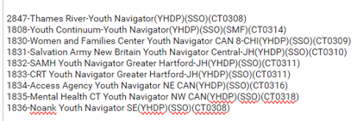
PIT App Training: Un-Sheltered HMIS and Non-HMIS
Similar to the count process last year, HMIS participating SO programs will be using the HMIS Current Living Situation Assessment
HMIS Youth Navigator SSO programs will be included and use the Current Living Situation Assessment as well.
The Head of Household for each client record will need the following to be counted on the night of PIT:
Open program enrollment
Current Living Situation Assessment dated for the night of the PIT count
A homeless setting selected as the current living situation

Slide 14
PIT App Training: Un-Sheltered HMIS and Non-HMIS
Non-HMIS SO and ES Warming Centers:
For these programs, the user will go to this link below to enter all persons encountered on the night of PIT, this includes each household member.
Non HMIS DOH Outreach and Warming Center Smart Sheet Form:
2025 SmartSheet Link: SmartSheet Intake Form
PIT Resources:
Unsheltered: https://cthmis.com/pit/

Slide 15
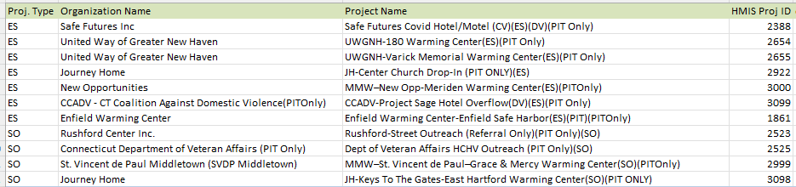
Non-HMIS Outreach and Warming Center Programs
List of Non-HMIS Outreach/Warming Centers:
The list of active SO and Warming Center ES programs are listed below.
These programs will be able to use the smart sheet intake form.
Nutmeg will de-duplicate the data and import into the appropriate program in the PIT app.
Programs listed will need to review and confirm in PIT App.

Slide 16
Non-HMIS Outreach and Warming Center Programs
CAN Specific Unsheltered Outreach Data:
For any client records that are not associated with a specific Outreach program – CANs will be able to enter that data into a CAN specific Non-HMIS Outreach program.
CANs will need to share their smart sheet of outreach clients who were counted on the night of PIT with Nutmeg.
Nutmeg will review for duplicates and send the sheet back to the CAN contact.
The CAN contact can then enter data in the CAN specific program in the PIT App within the next 2 business days of receiving the returned file.

Slide 17
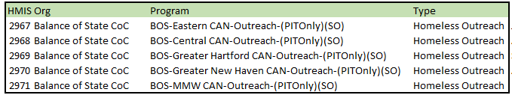
Non-HMIS Outreach and Warming Center Programs
The list of CAN specific, Non-HMIS Outreach programs are below.
Again, the purpose of these programs is to collect unsheltered client data for those who are not already being counted in another HMIS or Non-HMIS street Outreach Program.

Slide 18
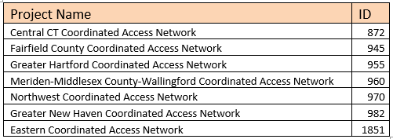
Non-HMIS Outreach and Warming Center Programs
New option for the CAN groups other than what was described on the previous slides:
As a final stopgap, for any records of unsheltered households on the night of the PIT count who are on the CAN Smartsheets, CANs will have the option of using the Coordinated Access Enrollment in HMIS for the PIT Count.
The CAN staff simply need to create a Current Living Situation Assessment using the CAN enrollment.
The CLA only needs to be created for those households who are determined to be literally homeless on the night of the PIT count. Once the CLA is created the data will auto populate in the PIT database under the Coordinated Access program.

Slide 19
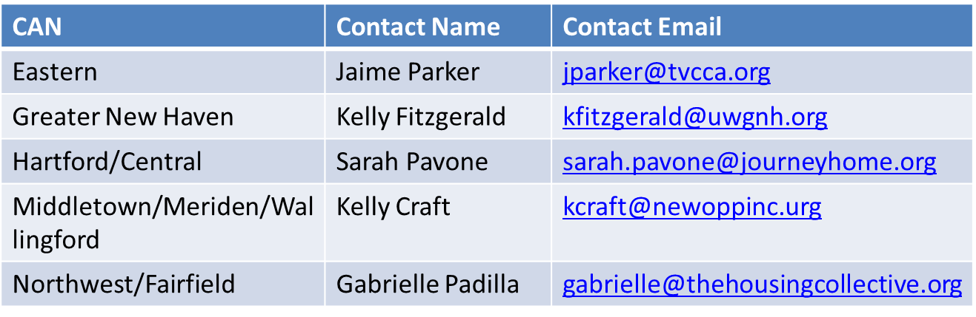
Non-HMIS Outreach and Warming Center Programs
CAN Outreach Contacts

Slide 20
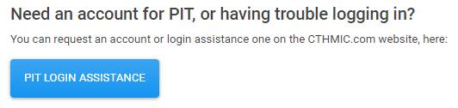
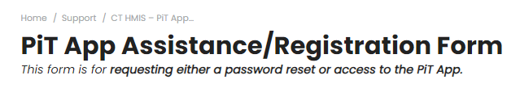
Reserved Bed Data Collection
New for 2024-2025 Count
Submit a help desk ticket button on the PIT login page - This button will be for any login issues or to register as a PIT DB user.
Clicking on the button will bring you the ticket submission form

Slide 21

PIT Database Demonstration

Slide 22
Important Dates & Resources
To Do:
Now: Update Current Living Situation Assessments (CLAs) and Client Lists as appropriate
Ensure all clients are enrolled in HMIS & have CLA completed within the past 90 days
Exit any clients no longer active from HMIS program
1/28/2025: Begin entering/confirming population data
See person on night of count or speak to person within 7 days after count to confirm where slept on 1/28/2025.
Cannot assume where person slept
2/4/2025: Data Entry deadline - 1 week after the night of the count
Notes:
Added 1st bullet
1/23/24: added sub-bullets
1/30/24 – if collecting data on smartsheets, this is the deadline to share the smartsheet w/ Nutmeg.

Slide 23
Important Dates & Resources
Project resources:
2024-2025 HIC/PIT Resource Website
If project not yet in the system, contact the help desk:
Help@NutmegIT.Com

Slide 24
Important Contact Information
Jim Bombaci Nutmeg IT Jim@NutmegIT.Com
Shannon Quinn-Sheeran Housing Innovations Shannon@HousingInnovations.US
Lindsay Fabrizio The Housing Collective Lindsay@TheHousingCollective.Org
Nutmeg Help Desk Help@NutmegIT.Com
CT BOS Contact ctboscoc@gmail.com
ODFC Contact Lindsay@TheHousingCollective.Org

Slide 25

Questions

