Slide 1

2025-2026 Un-Sheltered People Count Training
Un-Sheltered Programs:
PATH, Street Outreach and Non-ES Warming Centers

Slide 2
Important Contact Information
Jim Bombaci Nutmeg IT Jim@NutmegIT.Com
Shannon Quinn-Sheeran Housing Innovations Shannon@HousingInnovations.US
Lindsay Fabrizio The Housing Collective Lindsay@TheHousingCollective.Org
Nutmeg Help Desk Help@NutmegIT.Com
CT BOS Contact ctboscoc@gmail.com
ODFC Contact Lindsay@TheHousingCollective.Org

Slide 3
Meeting Agenda
Introductions
Roles and Responsibilities
Program Overview
PIT Database Demo
Key Dates
Summary
Questions/Close

Slide 4
Roles and Responsibilities
Project Management – PIT Leadership Team
Database Support – Nutmeg
HMIS Participating People Counts
Agency Staff
Non-HMIS Participating People Counts
Agency Staff

Slide 5
Federal Requirements for Counting People Experiencing Homelessness & Inventory
Purpose of Counts
HIC (Housing Inventory Count): Count units & beds (HMIS and Non-HMIS) dedicated to community members experiencing homelessness.
PIT (Point-in-Time Count): Count individuals experiencing homelessness in sheltered (in beds above) & unsheltered spaces (not meant for human habitation).
Timing of Counts
HIC: Completed in fall (except RRH); adjustments now for unknown/unexpected changes for 1/27/26. RRH completed at time of PIT count.
PIT: Conducted within the last 10 days of January. CT PIT count on 1/27/2026.
Notes:
LF Start

Slide 6

Federal Requirements for HIC & PIT (2)
Importance of the Counts
Snapshot of Homelessness: Provides annual insights into homelessness trends.
Goal
Use insights to review all homeless resources available in Connecticut to drive system development and potential future requests.

Slide 7
Point In Time Count
Why: Required by HUD. Combined with the HIC, the PIT shows the resources available compared to the current number of people needing those resources in each CoC.
PIT = people portion and counts the people experiencing homelessness on the night of the count
Completed via PIT database: agency staff either review (HMIS participant projects) or enter (non-HMIS participating projects) total people sleeping in the program on the night of the count
Regional Coordinators work with CoC Leadership, providers, and Nutmeg to ensure all projects enter and/or verify data in a timely fashion

Slide 8
Overview
The Point in Time (PIT) counts people experiencing homelessness within each Continuum of Care’s geographic region.
Populations included in PIT:
Emergency Shelter (ES)
Transitional Housing (TH)
Safe Haven (SH)
Unsheltered Situations
Street Outreach (SO)
Youth Navigator
Notes:
Considered homeless: Includes people in the TH portion of Joint TH-RRH programs & the folks in the RRH portion of this are considered in PH

Slide 9
Overview Continued
Unsheltered = people living in places not meant for human habitation, for example, outside, in bus stations, in cars, etc.
Non-ES Warming Centers = locations for people to come in out of the cold but do not have any beds, mats or cots and are not used as shelter

Slide 10
Unsheltered Count
HMIS Participating Agencies will rely on HMIS to review and confirm data, so it reports correctly in the PIT Database
Current Living Assessment Due Date 2/3/2026
NEW: DOH Warming Centers and DMHAS Street Outreach programs will use the Mobile Application
Local CANs keeping track of unsheltered on Smartsheets will need to provide their Smartsheets to Nutmeg for Duplicate review and will then enter their data into the appropriate PIT program.
The Smart Sheet forms will need to be completed by 2/3/2026

Slide 11
Important Links
PIT App link: PIT Database Link
Engage Mobile App:
https://poe.nutmegit.com/Engage/Identity/Account/Login
PIT Resource Page: https://cthmis.com/pit/
General User Guides
Unsheltered Programs Training Material
Sheltered Program Training Material
Notes:
Add any links to Mobile App guidance here.

Slide 12
Unsheltered Point-in-Time Count:
Outreach Strategies
Sarah Pavone, Journey Home, and Paul Lipp, Catholic Charities of Fairfield County
Notes:
Paul L Starts

Slide 13
Roadmap
Data Clean Up
Coordinating Outreach Coverage
Rural Challenges & Best Practices
Outreach Supplies & Safety
Questions for each Community

Slide 14
Data Clean Up
HMIS
Run Current Living Situation Reports
Review Program Enrollments for all SO programs
Who’s missing?
Smartsheets
Review Shelter Priority Lists
Data match SPL to By Name List
Outreach Referrals
Generic Enrollments now automatically close after 90 days of no documented services!
Notes:
Hford &Central – run the CLA report and verify correct; SP sends quarterly reports to SO teams w/ CLAs not complete w/in last 90 days; look @ program enrollments; if CLAs – unable to determine for 90 days or more, maybe have enrollments to close out. Helpful: Generic unsheltered enrollments if 90 days of no services.
- Look @ who is missing: ppl who’ve come up in convo but not in HMIS. Who on shelter priority list and who is not on BNL? Now need enroll in HMIS or clean up shelter priority list b/c no notes for a while. Come off of SO and smartsheet data. Then – look at folks in que for SO.

Slide 15

Coordinated Outreach
Identify Regional Lead and a Team Lead within your agency
Identify known locations/encampments and “hot spots”
Strategically plan for Street Outreach providers’ locations and schedules
Notes:
Once data in place, how coordinate teams to engage all and outreach to all locations during PIT.
JH has regional lead. Create sheet – listing out all encampments and hot spots and assigned team to each. Team stated date/time going there. Cretated mini SO plan for PIT week.

Slide 16

Rural Challenges & Best Practices
Rural communities face challenges associated with counting unsheltered households in hard to reach or unknown locations with minimal resources
Establish and/or expand partnerships with municipal and community partners such as law enforcement, Mckinney Vento Liaisons, and Libraries.
Consider an event or “pop up” with basic needs resources during the PIT count
Notes:
Paul:
Establish relationships with those who can identify unsheltered households in communities where canvassing isn’t feasible
Educate these partners about the PIT Count and stay in communication during the lead-up
In some cases, these partners may be able to verify living situations on night of PIT.
Includes municipal social services/human services depts., police depts., hospitals, McKinney-Vento liaisons, volunteer-run CW shelters

Slide 17
Outreach Supplies & Safety
Supplies: flashlights, vests, ID badges, clipboards, pens, maps, first-aid kits.
Communication: cell phones, shared locations, emergency contact list.
Survey tools: paper intakes/releases, mobile Engage app, or PIT approved survey form.
Basic Need Support: Socks, food, hygiene supplies, wound care kits, etc.
Harm Reduction: Safe use supplies, tents, thermal blankets, Narcan
Transportation: Ability to transport or access to Uber/ride share if able to divert or transfer to shelter

Slide 18
Questions for Each Community
Who is your regional lead for PIT? Is there a communication plan?
Who are the providers in your community who are not connected to the CAN/HMIS-participating?
Who are the individuals who are likely unsheltered but may not be engaged in services?
What are the locations/hotspots that would most benefit from boots-on-the-ground on the night of the PIT? Which provider will be there and when?
What hybrid approach can maximize accuracy and efficiency?

Slide 19
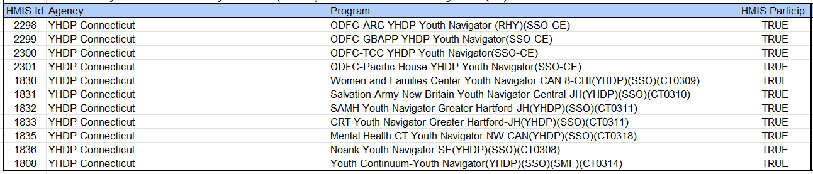
YHDP SSO Programs HMIS CLA
HMIS Youth Navigator SSO programs will continue to be included and use the Current Living Situation Assessment in HMIS
The Head of Household for each client record needs the following to be counted on the night of PIT:
Open program enrollment
Current Living Situation Assessment dated for the night of the PIT count
A homeless setting selected as the current living situation

Slide 20
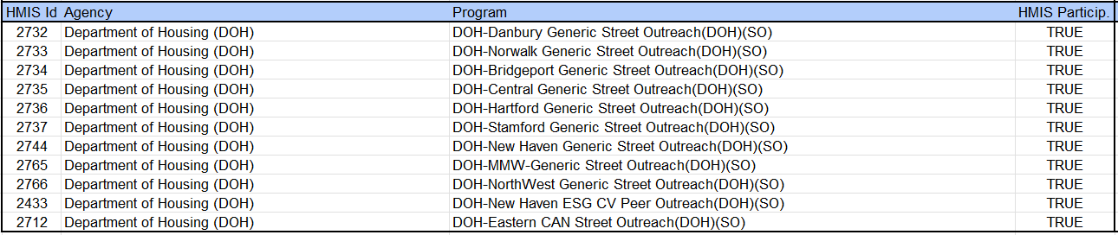
DOH Generic Street Outreach Programs HMIS CLA
HMIS DOH Generic Street Outreach programs that will continue to be included and use the Current Living Situation Assessment in HMIS
The Head of Household for each client record will need the following to be counted on the night of PIT:
Open program enrollment
Current Living Situation Assessment dated for the night of the PIT count
A homeless setting selected as the current living situation

Slide 21
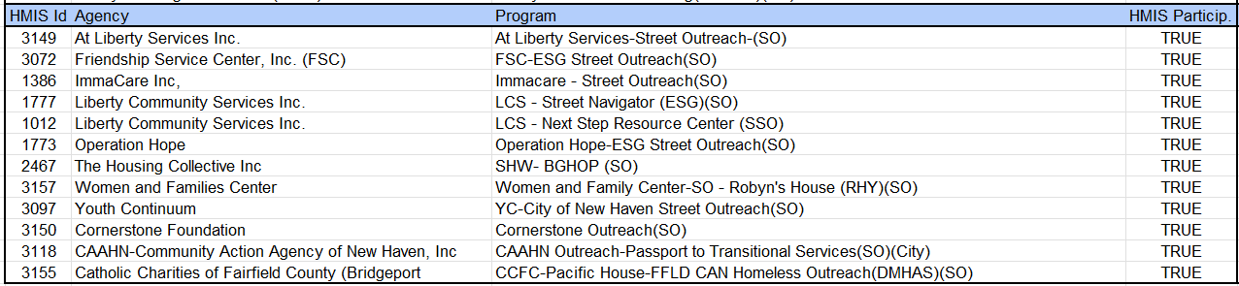
HMIS Street Outreach Programs HMIS CLA
HMIS Street Outreach programs that will continue to be included and use the Current Living Situation Assessment in HMIS
The Head of Household for each client record will need the following to be counted on the night of PIT:
Open program enrollment
Current Living Situation Assessment dated for the night of the PIT count
A homeless setting selected as the current living situation

Slide 22
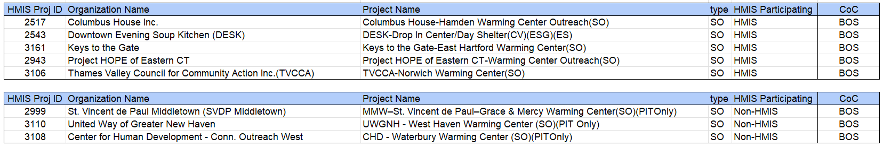
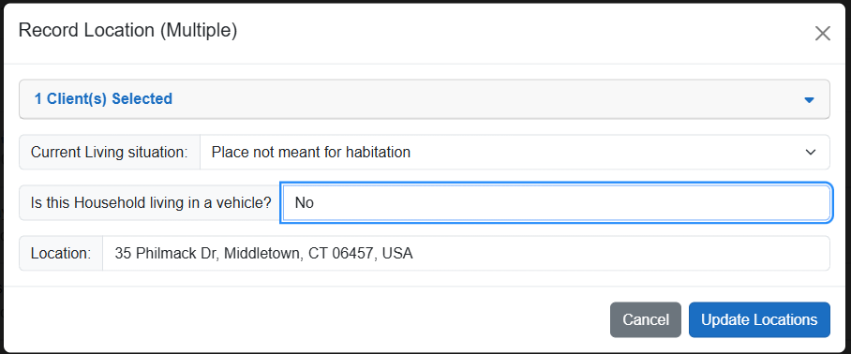
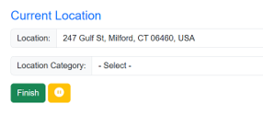
DOH Warming Center Programs Engage Mobile APP CLA
DOH Warming Outreach Centers will use the Mobile App to complete the following:
Current Living Assessment:
Warming Centers are not ES locations
These are places not meant for habitation
Vehicle Assessment – Just say ‘No’ to the vehicle question
Location information

Slide 23
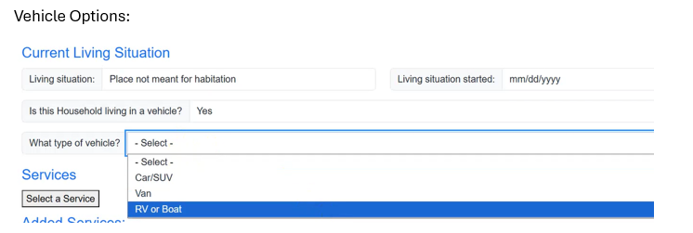
DMHAS Outreach Programs
All DMHAS Outreach Programs will use the Mobile App to complete the following:
Current Living Assessment
Vehicle Assessment
Note, You can not use the bulk CLA feature if one or more persons you are counting is in a vehicle. You will need to create their contacts one at a time in the mobile app.
You can only use the bulk service feature if all persons are in the same location and not in a vehicle.
Location information

Slide 24
Non-HMIS Street Outreach and Non-Engage Users
Non-HMIS Street Outreach programs who are NOT using the Mobile Application:
For these programs, the user will just need to manually enter their data into the PIT Database
PIT Link -- https://poe.nutmegit.com/AppCenter2
PIT Resources: Unsheltered: https://cthmis.com/pit/

Slide 25
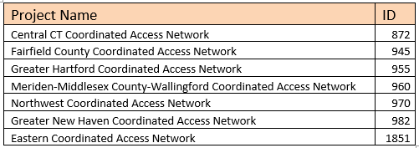
Non-HMIS Outreach Programs
CAN groups other than what was described on the previous slides:
As a final stopgap, for any records of unsheltered households on the night of the PIT count who are on the CAN Smartsheets, CANs will have the option of using the Coordinated Access Enrollment in HMIS for the PIT Count.
The CAN staff simply need to create a Current Living Situation Assessment using the CAN enrollment.
The CLA only needs to be created for those households who are determined to be literally homeless on the night of the PIT count. Once the CLA is created the data will auto populate in the PIT database under the Coordinated Access program.

Slide 26
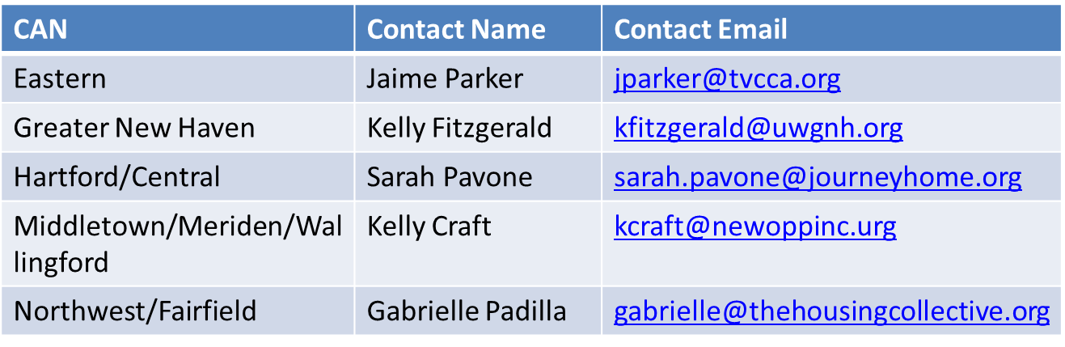
Non-HMIS Outreach and Warming Center Programs
CAN Outreach Contacts

Slide 27
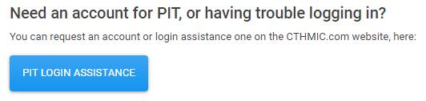
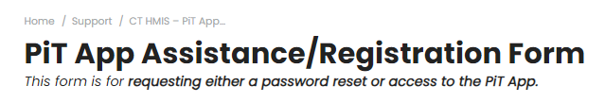
PIT Count Support
Continued for 2025-2026 Count
Submit a help desk ticket button on the PIT login page - This button will be for any login issues or to register as a PIT DB user.
Clicking on the button will bring you the ticket submission form

Slide 28

PIT Database Demonstration

Slide 29
Important Dates & Resources
To Do Now:
Ensure your team resources are in place
HMIS Programs not using mobile app:
Update CLA/Exit clients who have not had a CLA in the last 90 Days
Only create a CLA on the night of PIT for those clients you contacted
Mobile App Using Programs:
Update CLA/Exit clients who have not had a CLA in the last 90 Days
Only create a CLA in the Mobile App for those clients you contacted
Smartsheet using programs:
If the client data for your CAN is only available on your CAN’s SmartSheet then you can submit that smart sheet to Nutmeg.
Ensure you have the updated link and are familiar with the data required
Send any questions to the Nutmeg help desk: help@nutmegit.com.
1/27/2026: Begin entering/confirming population data
See person on night of count or speak to person within 7 days after count to confirm where slept on 1/27/2026.
Cannot assume where person slept
2/3/2026: Data Entry deadline - 1 week after the night of the count
Notes:
All programs in HMIS – update CLA so that you know generally where the participant has been sleeping. If helps – update case notes with specifics so you can find and count on PIT night.
All programs – update client lists so are working on most up-to-date information possible for PIT.
Mobile app programs – download to whatever device you will be using to record PIT and test so you are familiar with how it works.

Slide 30
Important Dates & Resources
Project resources:
2025-2026 HIC/PIT Resource Website
If project not yet in the system, contact the help desk:
Help@NutmegIT.Com

Slide 31
Important Contact Information
Jim Bombaci Nutmeg IT Jim@NutmegIT.Com
Shannon Quinn-Sheeran Housing Innovations Shannon@HousingInnovations.US
Lindsay Fabrizio The Housing Collective Lindsay@TheHousingCollective.Org
Nutmeg Help Desk Help@NutmegIT.Com
CT BOS Contact ctboscoc@gmail.com
ODFC Contact Lindsay@TheHousingCollective.Org

Slide 32

Questions

